Slide 1
E-Commerce
Analysis
Group - I
*Shruthika *Shreya
*Boguda Devendranath

Slide 2
E-Commerce Analysis
Objectives
Reduce average delivery time
Boost customer order conversion
Strengthen high-performing seller partnerships
Increase weekend sales
Leverage monthly sales trends

Slide 3




TOOLS USED
Excel
Power BI
Tableau
SQL

Slide 4


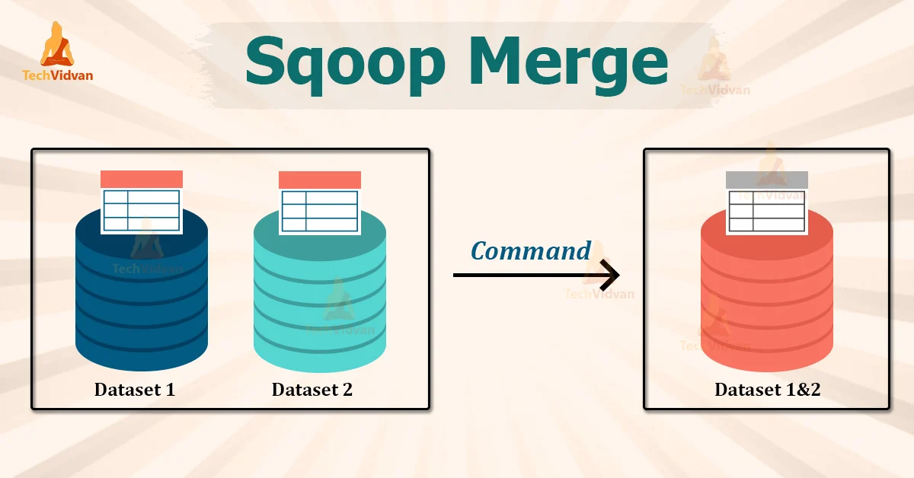
WORK EXPERIENCE
Merging Dataset
Data Cleaning
Interactive Dashboard

Slide 5
01.
Excel

Slide 6
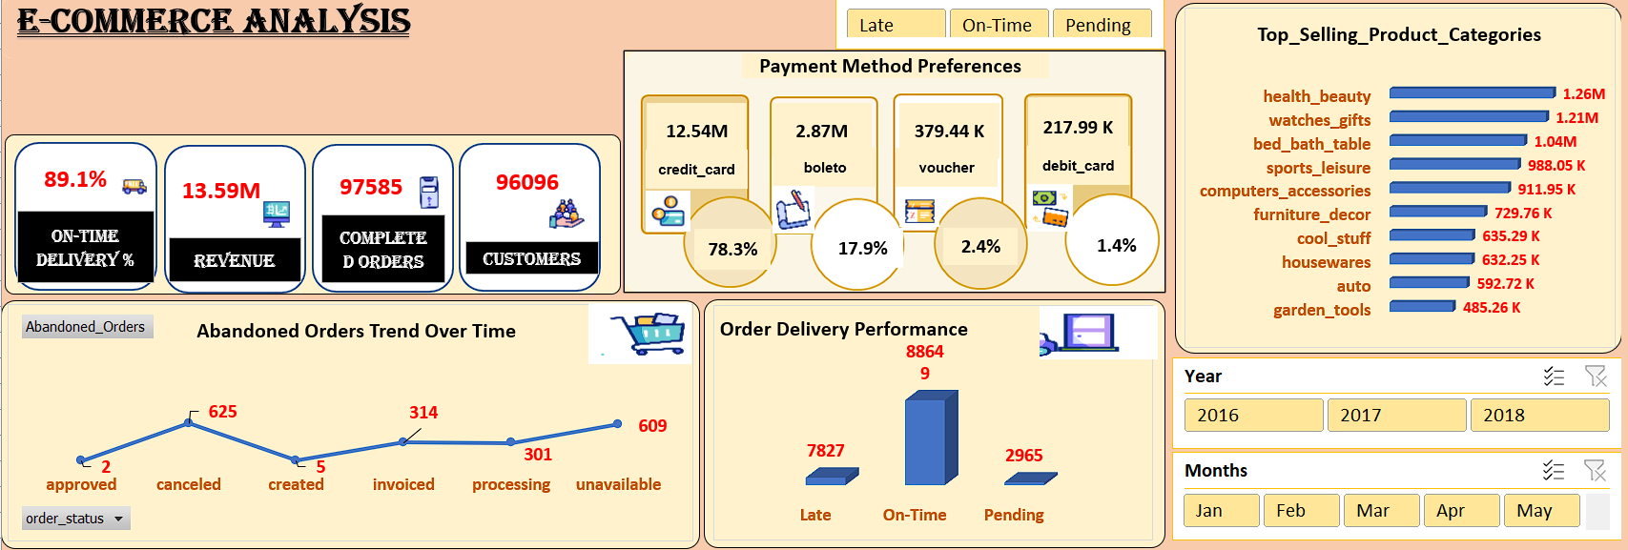

Slide 7
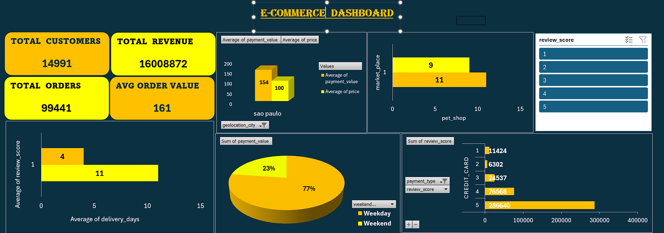

Slide 8
02.
Power BI

Slide 9
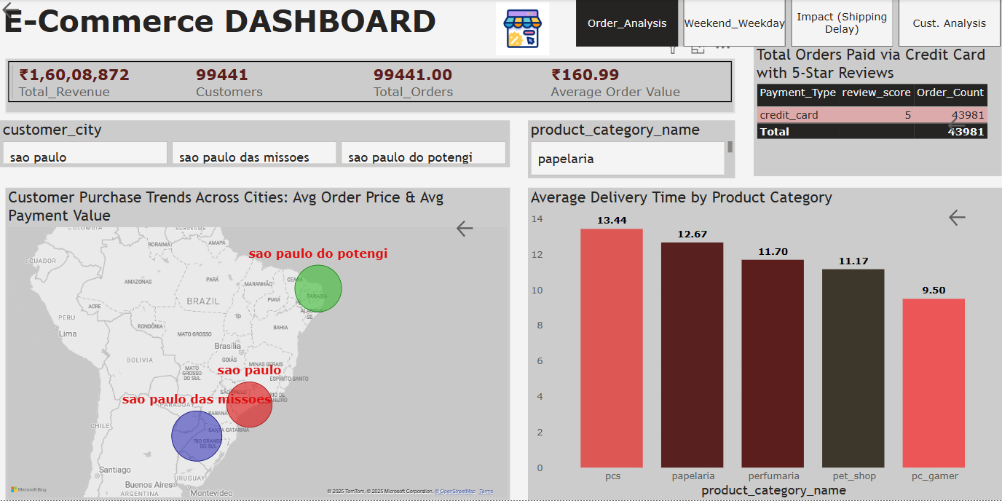

Slide 10
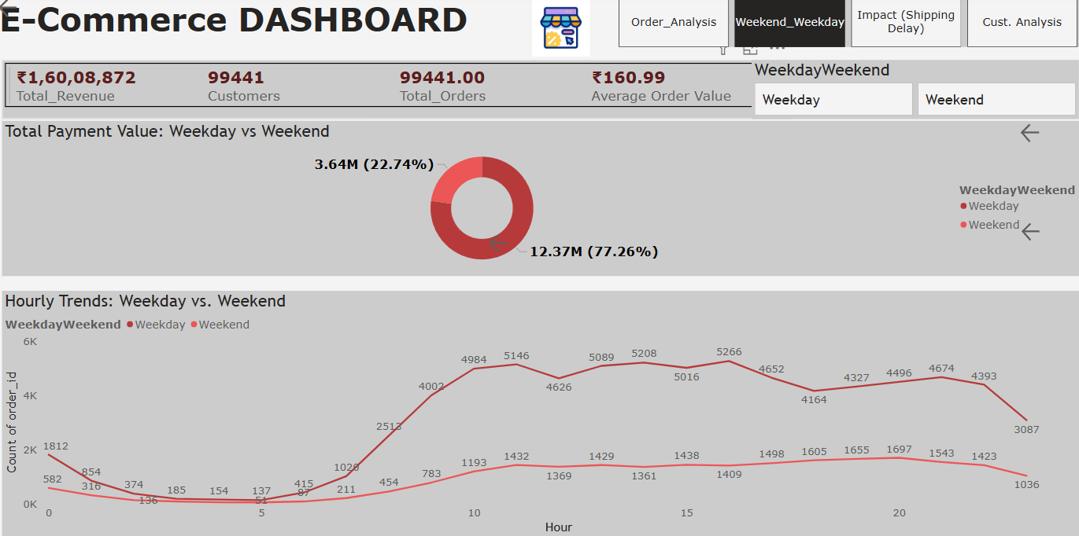

Slide 11
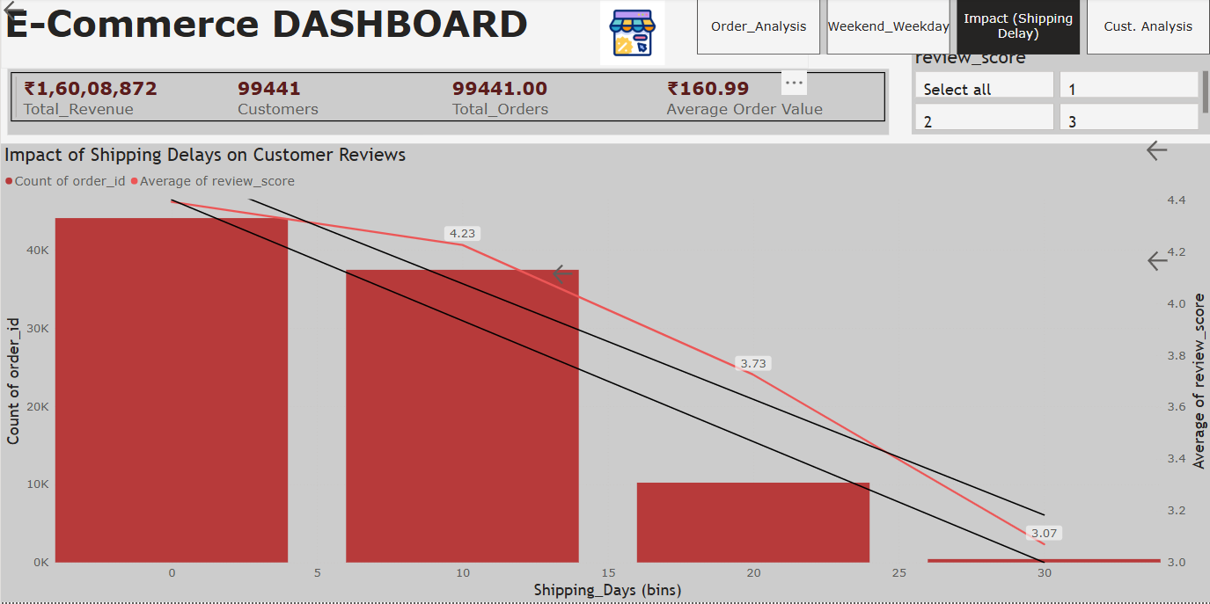

Slide 12
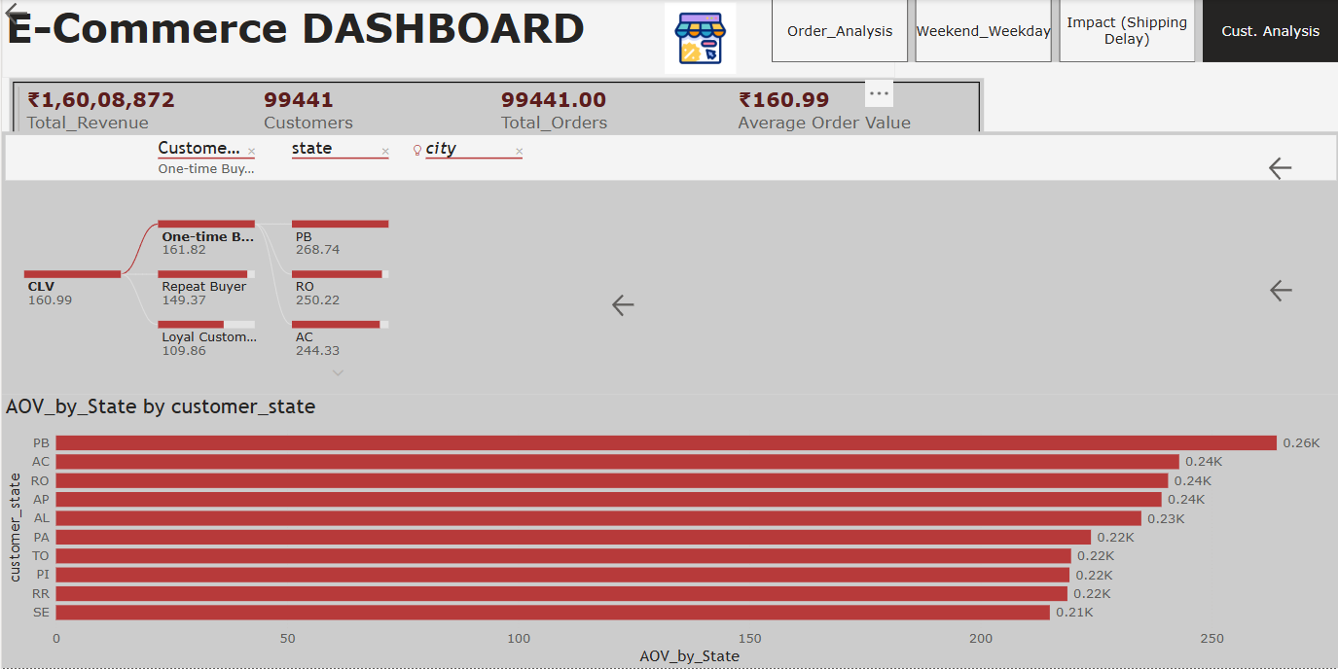

Slide 13
03.
Tableau

Slide 14
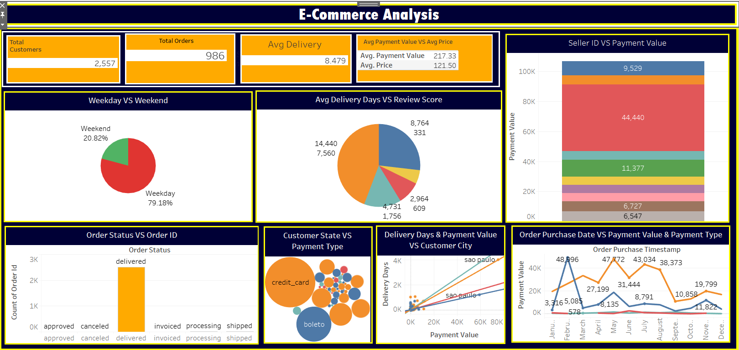

Slide 15
KPIs

Slide 16
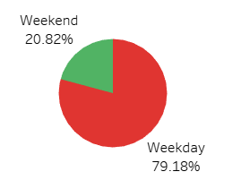
Weekday vs Weekend (order_purchase_timestamp) Payment Statistic
Most orders are placed on weekdays (79.18%), while only 20.82% occur on weekends, indicating a significant drop in customer activity during weekends.

Slide 17
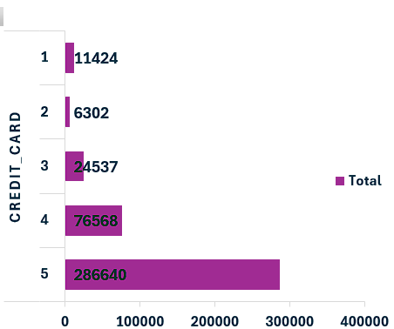
Number of Orders with Review Score 5 and Payment Type as Credit Card
The pie chart shows that 8,764 customers gave a 5-star review, out of which a substantial portion used credit cards, as shown in the bubble chart where credit_card is the dominant payment method.

Slide 18
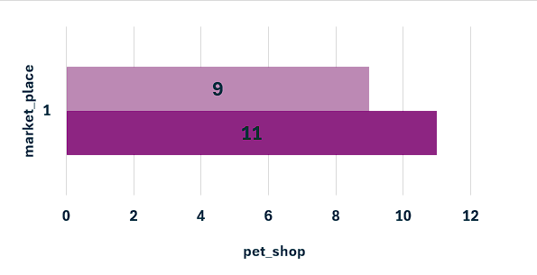
Average Number of Days Taken for Order Delivery in Pet Shop Category
Based on delivery metrics by review score, it can be inferred that most high review scores align with lower delivery days. If filtered for pet_shop, average delivery days can be approximated similarly.

Slide 19
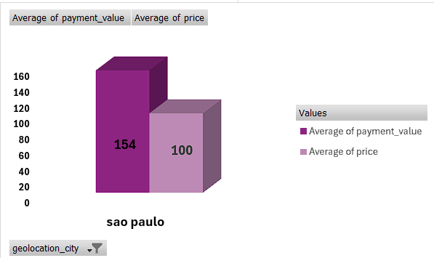
Average Price and Payment Values from Customers of São Paulo CityDelivery in Pet Shop Category
The line graph and scatter plot show São Paulo has higher payment values. Based on trends, average payment value and price are significantly above other cities (Avg Payment Value: ₹217.33, Avg Price: ₹121.50).

Slide 20
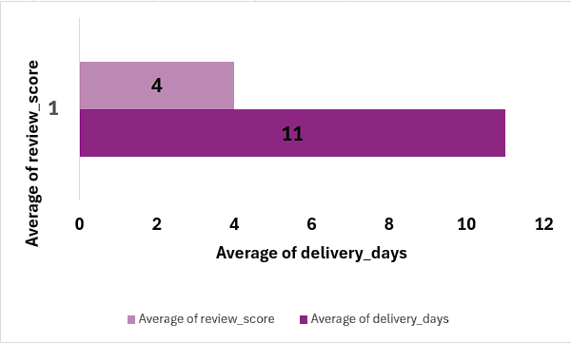
Relationship Between Shipping Days and Review ScoresCustomers of São Paulo CityDelivery in Pet Shop Category
The pie chart comparing avg delivery days vs review score shows that shorter delivery times tend to receive higher ratings (e.g., 5-star reviews correspond with faster deliveries).

Slide 21
Recommendations to Improve the Analysis
Add Filters for Product Categories
Including filters like pet_shop, electronics, etc., will help drill down into specific performance areas.
Segment Data by Customer Demographics
Analyzing data by age group, gender, or region could uncover hidden purchasing patterns.
Include Return and Cancellation Metrics
This would help evaluate post-purchase behavior and improve service strategies.
Track Repeat Purchase Rates
Understanding customer loyalty and repeat buying can guide retention strategies.

Slide 22
Conclusion
This E-Commerce analysis reveals that customer satisfaction is closely tied to delivery speed and payment convenience. Most orders are placed during weekdays using credit cards, with São Paulo contributing significantly to total sales. Higher review scores are associated with quicker deliveries, highlighting the importance of operational efficiency in enhancing customer experience.

Slide 23
Thank You

